Slide 1






Product Demo
PriceComp
(A Marketplace Product Price Comparator App)
Team Name: S.E.N.D.
Course: CIS 553 - 002, Fall 2022
Group Members:
Nayan Patel
Steve Anderau
Ethan Pellegrini
Dheeraj Mohanbabu

Slide 2
Agenda
Team Introduction
What is PriceComp App?
Main Features
Addon Features
Main Scenario
Product Technical Details
Known Issues and Limitations
Product Support

Slide 3




Team Intro
Nayan Patel
Steve Anderau
M.S. in Artificial Intelligence
M.S. in Software Engineering
Ethan Pellegrini
Dheeraj Mohanbabu
M.S. in Artificial Intelligence
M.S. in Artificial Intelligence

Slide 4
What is PriceComp App?
eCommerce business is growing exponentially
More and more choices of product and online marketplaces available
More choices make consumer’s product searching difficult
PriceComp is designed to make consumer’s product search journey easy
PriceComp provides comprehensive platform to search and compare products across various eCommerce sites
With a single click, provides all product data (e.g., price, rating) from various marketplaces

Slide 5
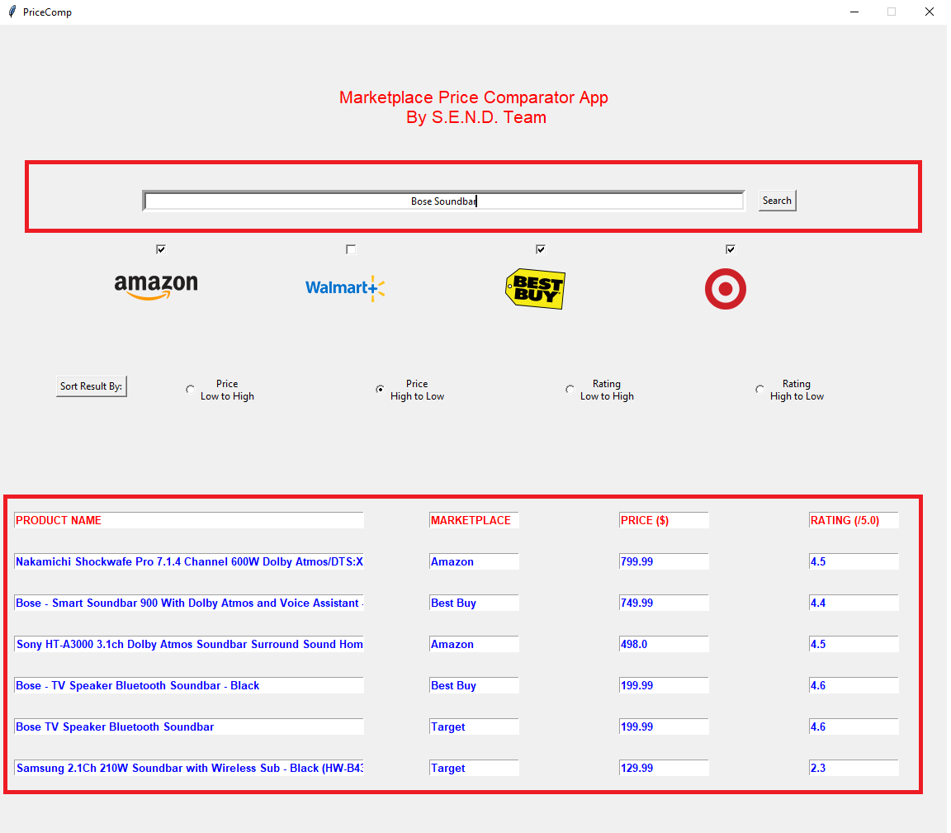
Main Features
Search Product
Display Product Data

Slide 6
Main Features: Search Product
The main feature of the PriceComp app is to search the product on various marketplace sites (amazon.com, bestbuy.com, walmart.com and target.com)

Slide 7
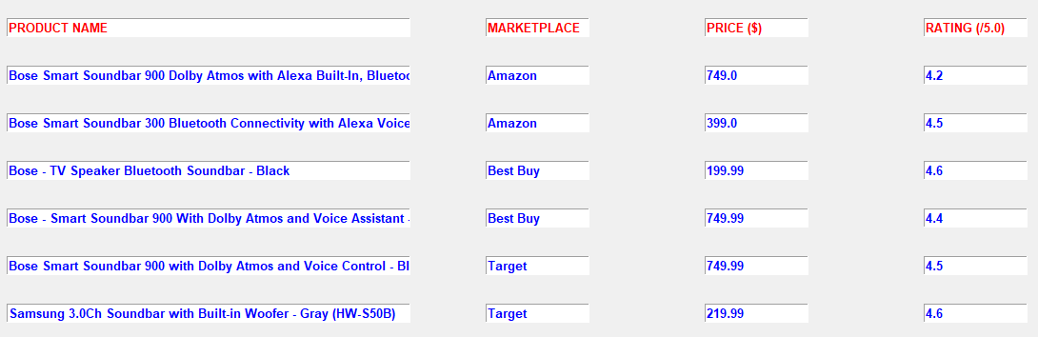
Main Features: Display Product
This user input is searched across the selected marketplace sites and the scraped product data will be displayed

Slide 8
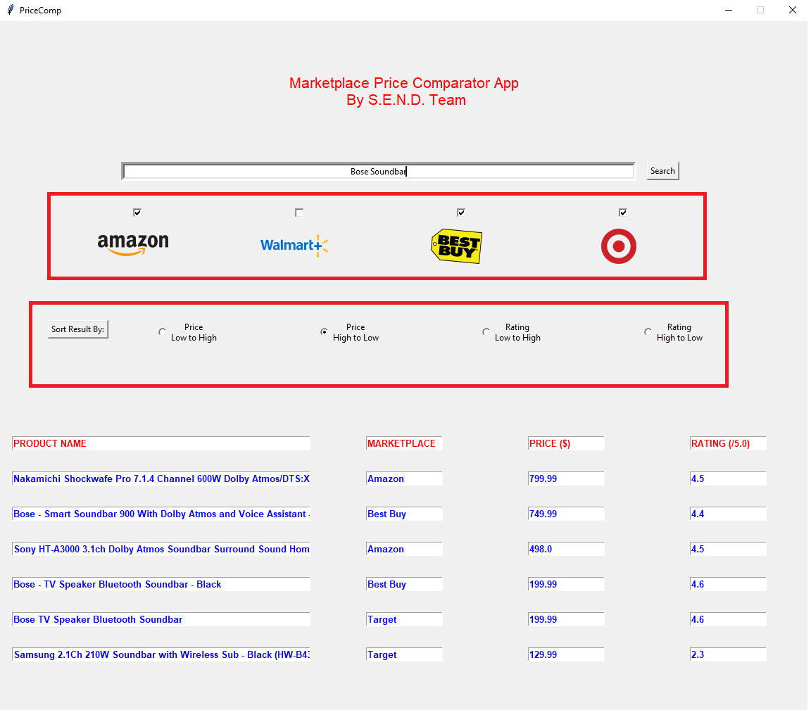
Addon Features
Select Marketplace Sites
Sort Search Results

Slide 9
Addon Features: Select Marketplace Sites
PriceComp offers the user the ability to select from four different marketplace sites that they can search for their product: Amazon, Walmart, Best Buy, and Target

Slide 10
Addon Features: Sort Search Results
The user may want insight into the searched products in a way that isn’t visible through the initial results, so a Sort function was added to our UI

Slide 11


Main Scenario
User enters the product keyword or SKU# in the search text box which is located on top of the UI window
After the search text is entered, as a next step, the user selects which marketplace sites they want to search the product
Once the user selects the marketplace sites, they click on the “Search” button which is located right next to the text box

Slide 12
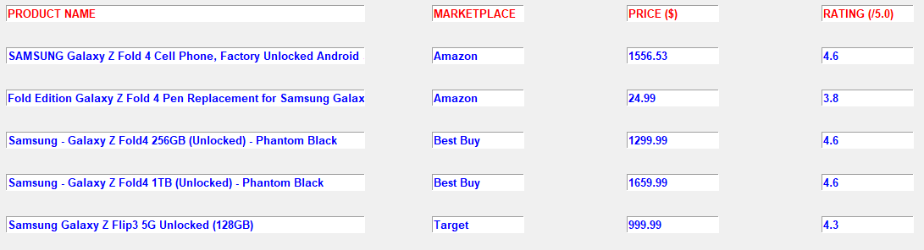

Main Scenario (contd.)
Once all the sites are searched and product data are collected, the data is displayed in tabulated form on the bottom of the UI window
As an option, user can choose sort by option and clicks on “Sort Result By:” button

Slide 13
Product Technical Details
PriceComp app is built on Python 3.10
Works on Windows, Linux and MacOS
Python Libraries used:
It requires chrome browser and chromedriver
Some user configuration is required
selenium
BeautifulSoup
tkinter
PIL (Python Imaging Library)
pandas
requests

Slide 14
Known Issues and Limitations
Sometimes, keyword Search Results are not accurate
walmart.com scraping not working
Selection of marketplace sites is mandatory

Slide 15
Product Support
For any question or product support, reach out to any of the S.E.N.D team members:
Nayan Patel (nayanpat@umich.edu)
Steve Anderau (standera@umich.edu)
Ethan Pellegrini (epellegr@umich.edu)
Dheeraj Mohanbabu (dheerajm@umich.edu)

Slide 16
Thank you for using PriceComp We Hope You Enjoyed it ☺

